Slide 1

Where Do Strategic Minerals Come From?
Data 608 Story 7-Yina Qiao

Slide 2
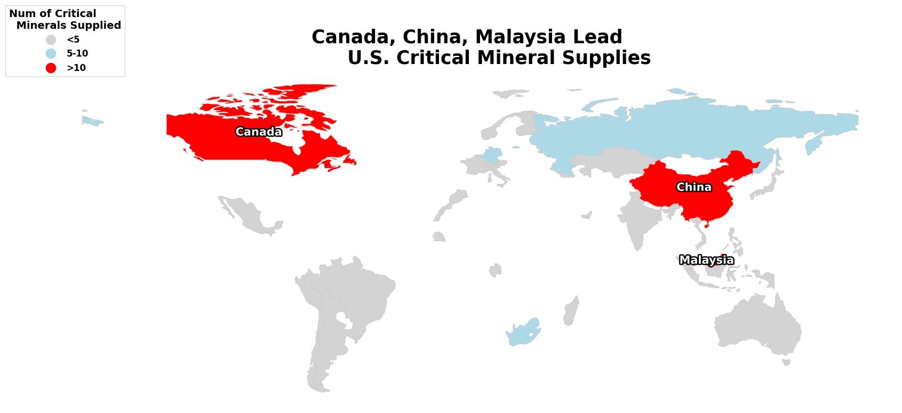

Slide 3
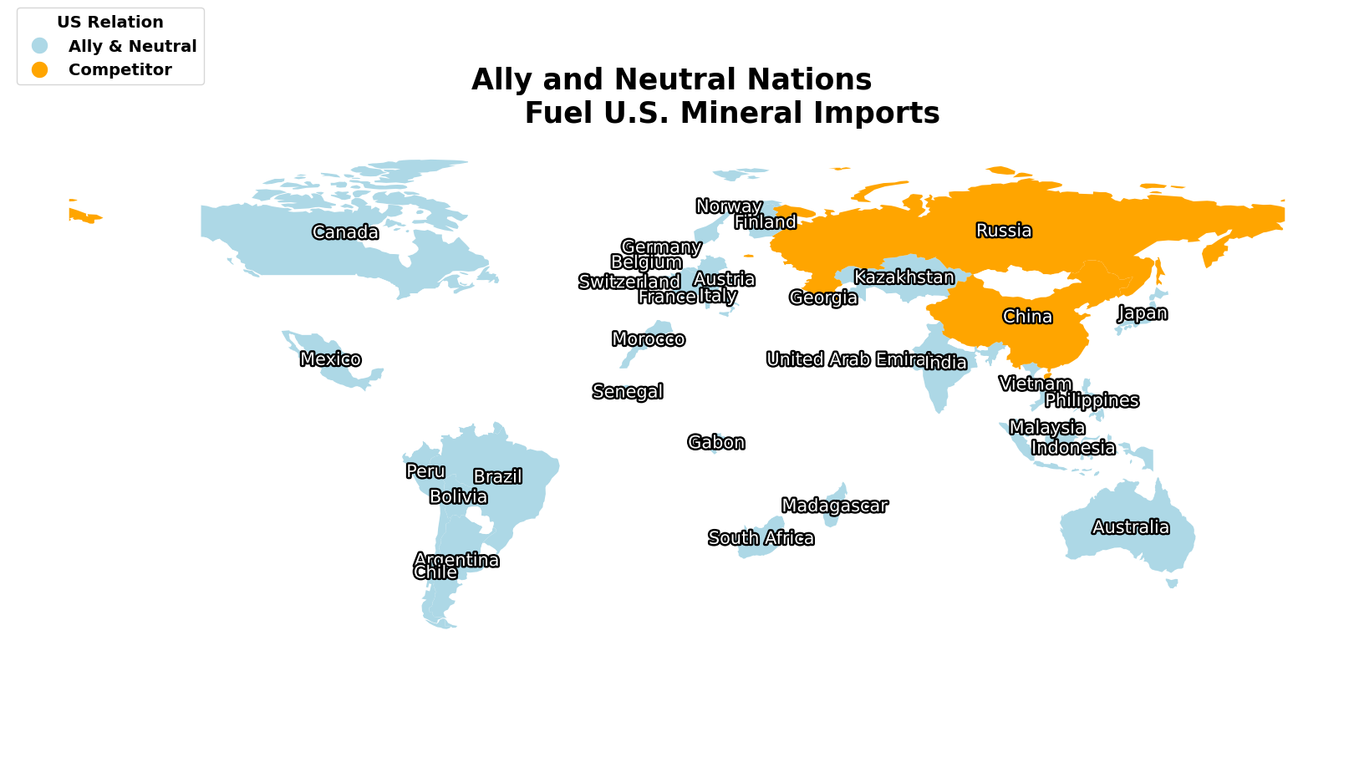

Slide 4
